Slide 1


Jose Luis
29 April 2024

Slide 2

Outline
Executive Summary
Introduction
Methodology
Results
Conclusion
Appendix

Slide 3
Executive Summary
Summary of methodologies
Data Collection through API
Data Collection with Web Scraping
Data Wrangling
Exploratory Data Analysis with SQL
Exploratory Data Analysis with Data Visualization
Interactive Visual Analytics with Folium
Machine Learning Prediction
Summary of all results
Exploratory Data Analysis
Interactive analytics
Predictive Analytics

Slide 4
Introduction
Project background and context
In this capstone, we will predict if the Falcon 9 first stage will land successfully. SpaceX advertises Falcon 9 rocket launches on its website with a cost of 62 million dollars; other providers cost upward of 165 million dollars each, much of the savings is because SpaceX can reuse the first stage. Therefore if we can determine if the first stage will land, we can determine the cost of a launch. This information can be used if an alternate company wants to bid against SpaceX for a rocket launch. In this lab, you will collect and make sure the data is in the correct format from an API. The following is an example of a successful and launch.
Problems you want to find answers
Launch success rate analysis
Preferred orbits analysis
Failed missions analysis
Predictive modeling for launch success

Slide 5

Section 1

Slide 6
Methodology
Executive Summary
Data collection methodology:
Data was collected using SpaceX API and web scraping from Wikipedia.
Perform data wrangling
One-hot encoding was applied to categorical features
Perform exploratory data analysis (EDA) using visualization and SQL
Perform interactive visual analytics using Folium and Plotly Dash
Perform predictive analysis using classification models
How to build, tune, evaluate classification models

Slide 7
Data Collection
Data sets was collected using the next method
Get request from de SpaceX API
Parsing the SpaceX Launch Data
Decode the response content as a JSON
Creating a Pandas DataFrame: We transformed the decoded JSON data into a Pandas DataFrame
Data Cleaning and Filtering

Slide 8
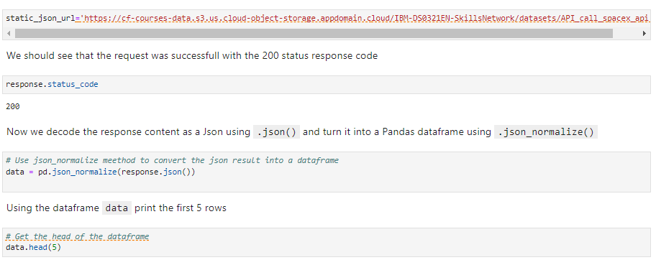
Data Collection – SpaceX API
We get request from SpaceX API, Parsing SpaceX Launch Data, Decoding Response Content as JSON, Creating a Pandas DataFrame and Data Cleaning and Filtering
GitHub URL of the completed SpaceX API calls notebook:
https://github.com/whluiz/SpaceX-Falcon-Collecting-the-data/blob/588ed300cab97e9fbcbccd79a0f919c4b50b8a92/jupyter-labs-spacex-data-collection-api.ipynb

Slide 9
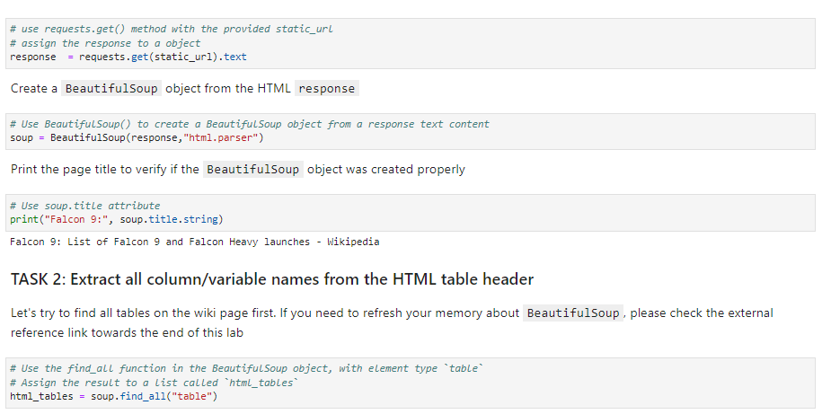
Data Collection - Scraping
HTTP GET Request to SpaceX Website, Create a Beautiful Soup Object, Extract Columns from HTML Tables, Parsing and Creating a DataFrame.
GitHub URL of the completed web scraping notebook:
https://github.com/whluiz/Space-X-Falcon-Web-scraping/blob/b67c0e3e955052513f664a3d1a49010925052de5/jupyter-labs-webscraping%20(2).ipynb

Slide 10
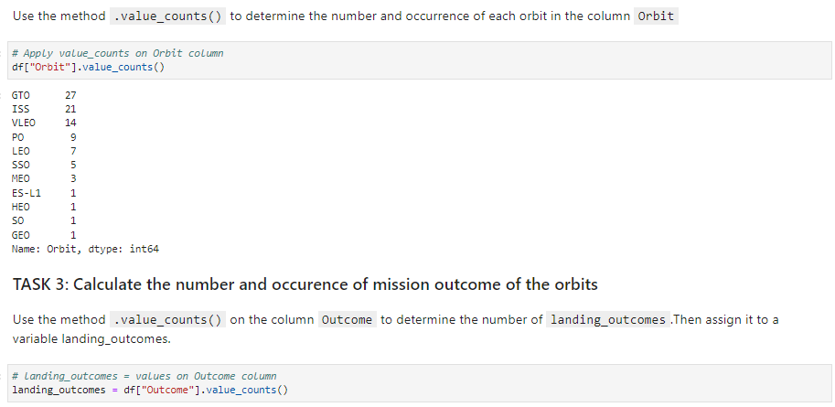
Data Wrangling
Load the SpaceX dataset, Calculate the Number of Launches from Different Facilities, Calculate the Occurrence of each orbit, Create a landing outcome, Determinate the success rate.
Add the GitHub URL of the completed data wrangling related notebooks:
https://github.com/whluiz/Data-Wrangling/blob/e238958fd7f2bec624ea1b55b362adb6b03a47ae/labs-jupyter-spacex-Data%20wrangling.ipynb

Slide 11
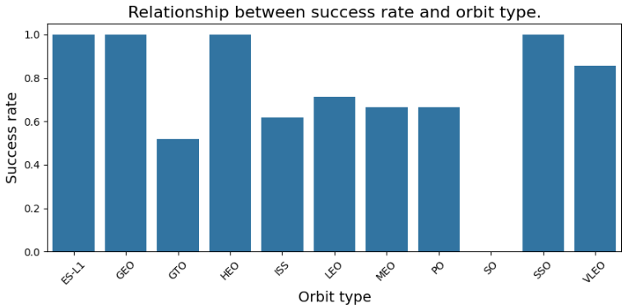
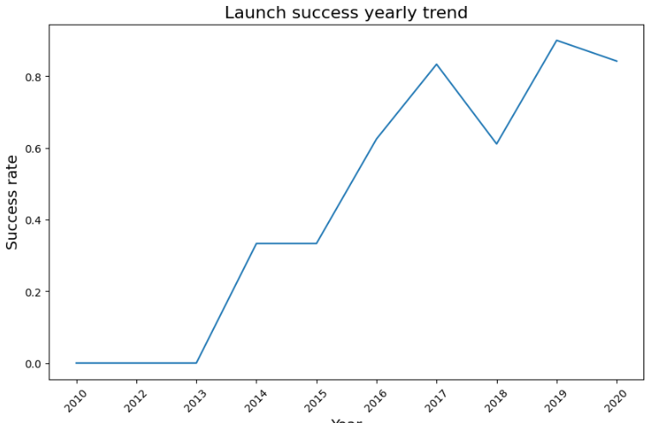
EDA with Data Visualization
To explore the relationship between variables, we employed both catplot and scatterplot techniques, we focused on the following variables: launch site, flight number, and payload mass., We utilized a bar chart to examine the Relationship between success rate and orbit type and a lineplot to analyze the relationship between success rate and year, by plotting we could identify trends and potential correlations.
GitHub URL of the completed EDA with data visualization notebook: https://github.com/whluiz/EDA-with-Visualization/blob/3121ab58d3539aeaea6e63b813d251c76d446a39/edadataviz.ipynb

Slide 12
EDA with SQL
We loaded the SpaceX dataset and applied EDA with SQL to get insight from the data, we wrote and execute SQL the following queries:
Unique Launch Site Names
Launch Sites Starting with ‘CCA’
Total Payload Mass by NASA (CRS) Boosters
Average Payload Mass by F9 v1.1 Booster Version
First Successful Ground Pad Landing Date
Boosters with Drone Ship Success and Payload Mass 4000-6000
Total Successful and Failed Mission Outcomes
Booster Versions with Maximum Payload Mass
Records for Month Names, Drone Ship Failure Landings, Booster Versions, and Launch Sites in 2015
Ranking of Landing Outcomes (Success/Failure) between 2010-06-04 and 2017-03-20
GitHub URL of the completed EDA with SQL notebook: https://github.com/whluiz/EDA-SQL1/blob/1f42bab730bd10f1657ddf3dacef7342979059c2/jupyter-labs-eda-sql-coursera_sqllite%20(2).ipynb
GitHub URL of the completed EDA with SQL notebook, as an external reference and peer-review purpose

Slide 13
Build an Interactive Map with Folium
We do the following tasks for map Visualizations:
Map Visualization: The data is plotted on a Folium Map object, which allows for interactive exploration.
Launch Sites: The map displays marked launch sites, each corresponding to a specific location.
Launch Outcomes: Additional information, such as launch outcomes, is overlaid on the map. This helps identify sites with high success rates.
Distance Calculations: Distances between launch sites and their proximities are calculated and visualized.
Insights: By combining these elements, we can uncover interesting insights related to the geographical distribution of launch sites.
This approach provides a comprehensive view of launch site locations and their associated factors.
GitHub URL of the completed interactive map with Folium map notebook: https://github.com/whluiz/Interactive-Visual-Analytics-with-Folium-lab/blob/2adedb0cb00bfbb91c7d345702930a035ae48baf/lab_jupyter_launch_site_location%20(1).ipynb

Slide 14
Build a Dashboard with Plotly Dash
We created an insightful and interactive dashboard:
Interactive Dashboard with Plotly Dash.
We harnessed the power of Plotly Dash to construct an interactive web application for data visualization.
Pie Charts for Total Launches.
These visualizations provide a clear overview of launch outcomes, making it effortless to compare success rates across different sites.
Scatter Graphs for Payload Mass and Outcome.
Through scatter graphs, we delved into the relationship between payload mass (kg) and launch outcomes.
GitHub URL of the completed Plotly Dash notebook:
https://github.com/whluiz/SpaceX-Launch-Records-Dash/blob/ab1e4c3b45f77a996bd2bda67723288a8cfff801/Ploty%20Dash

Slide 15
Predictive Analysis (Classification)
The steps we took were as follows:
Data Loading and Transformation:
We harnessed the power of NumPy and Pandas to load and preprocess our data.
Data Splitting:
We divided our dataset into training and testing subsets.
Model Building and Hyperparameter Tuning:
We constructed various machine learning models, exploring different algorithms.
Evaluation Metric: Accuracy:
We chose accuracy as our evaluation metric. It measures how well our model predicts the correct class labels.
The Best Performing Model:
After rigorous experimentation, we identified the best classification model.
GitHub URL of the completed predictive analysis lab notebook: https://github.com/whluiz/SpaceX-MAchine-Learning-Predicition/blob/ce7f1a6d5cc4d949d2d7738461040f345ee0318f/SpaceX_Machine%20Learning%20Prediction_Part_5%20(1).ipynb

Slide 16
Results
Exploratory data analysis results
Interactive analytics demo in screenshots
Predictive analysis results

Slide 17

Section 2

Slide 18
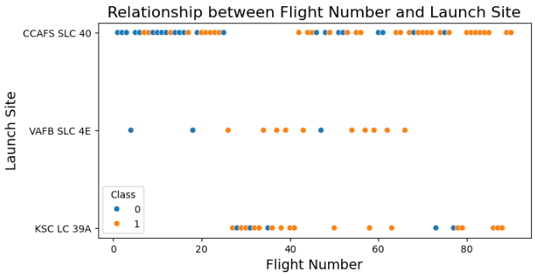
Flight Number vs. Launch Site
This graph provides insights into the relationship between flight numbers and launch sites, allowing us to understand the geographical distribution of launches.

Slide 19
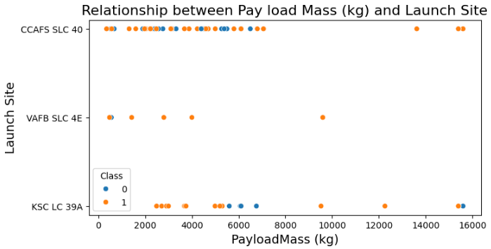
Payload vs. Launch Site
We find for the VAFB-SLC launchsite there are no rockets launched for heavypayload mass(greater than 10000).

Slide 20

Success Rate vs. Orbit Type
From the plot, we can see that ES-L1, GEO, HEO, SSO, VLEO had the most success rate.

Slide 21
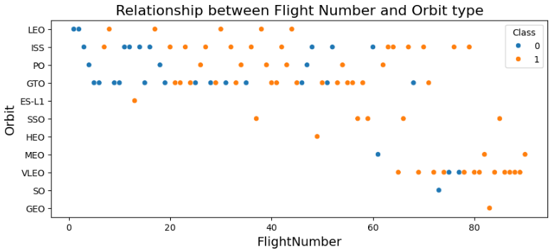
Flight Number vs. Orbit Type
We observe that in the LEO orbit the Success appears related to the number of flights, in the GTO orbit, there is no relationship between flight number and the orbit.

Slide 22
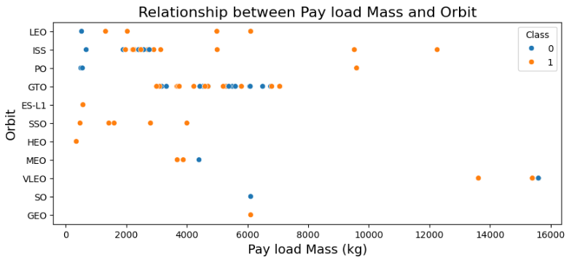
Payload vs. Orbit Type
We can observe that with heavy payloads, the successful landing are more for PO, LEO and ISS orbits.

Slide 23
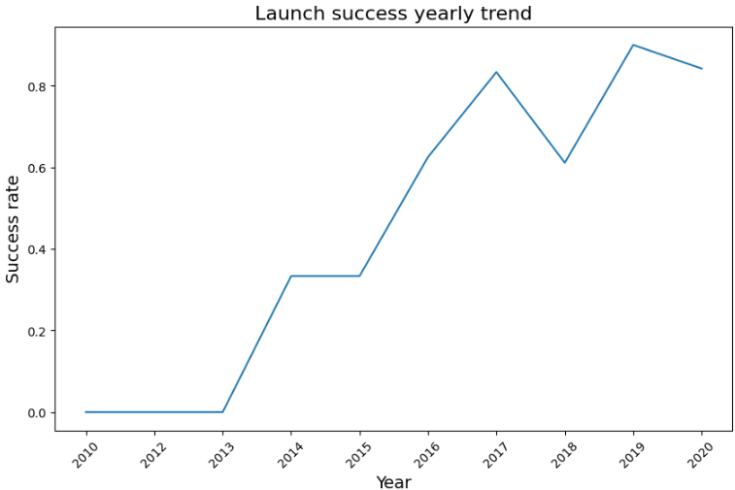
Launch Success Yearly Trend
From the plot, we can observe that success rate since 2013 kept on increasing till 2020

Slide 24
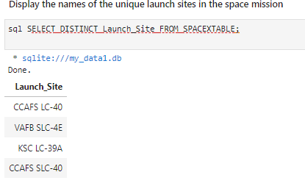
All Launch Site Names
The goal is to display the names of unique launch sites related to space missions.
The query fetches distinct launch site names from the table named SpaceXtable

Slide 25
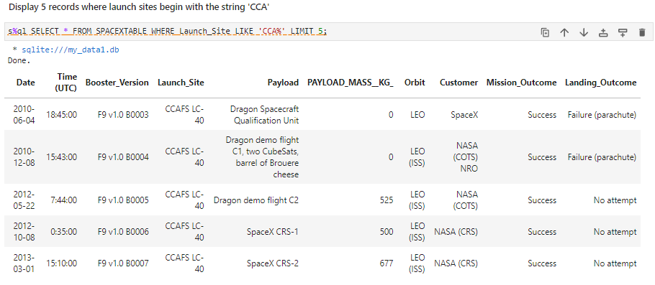
Launch Site Names Begin with 'CCA'
We used the next query to display 5 records where launch sites begin with ‘CCA’
`

Slide 26
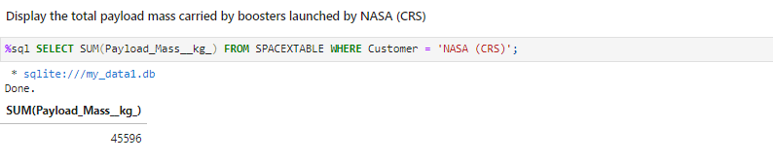
Total Payload Mass
The SQL query calculates the total payload mass carried by boosters launched by NASA (CRS). The result of the query is 45,596 kg.

Slide 27
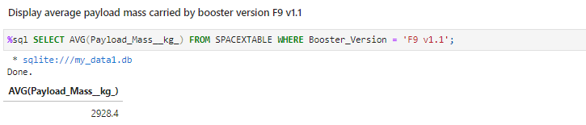
Average Payload Mass by F9 v1.1
We calculated the average payload mass carried by booster version F9 v1.1 as 2928.4

Slide 28
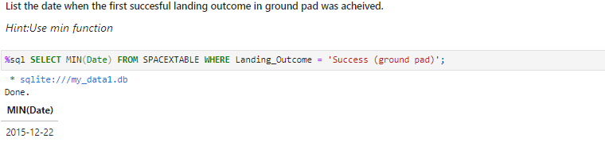
First Successful Ground Landing Date
We observed that the dates of the first successful landing outcome in ground pad was 2015- 12-22

Slide 29
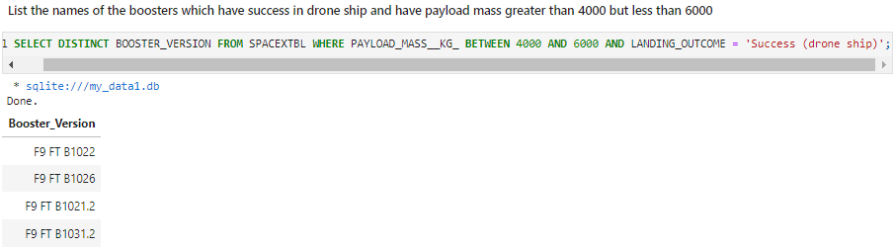
Successful Drone Ship Landing with Payload between 4000 and 6000
This SQL query aims to retrieve the names of boosters that have successfully landed on a drone ship and whose payload mass is greater than 4000 kg but less than 6000 kg

Slide 30
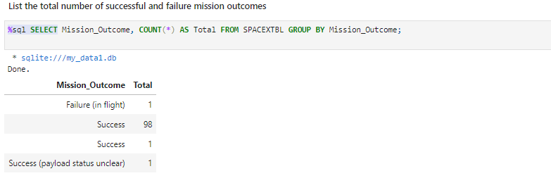
Total Number of Successful and Failure Mission Outcomes
We used this query to group the results by the mission outcome (success or failure) and count how many times each outcome appears.

Slide 31
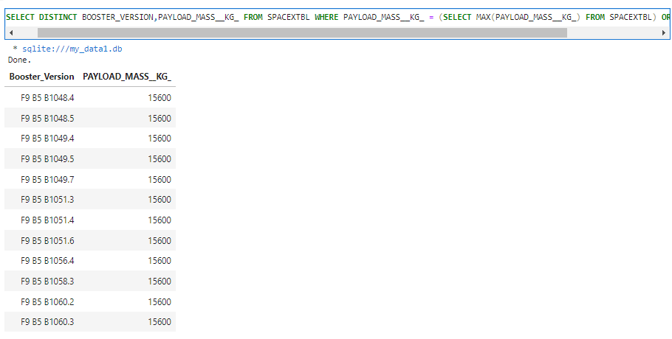
Boosters Carried Maximum Payload
We used this query to give us a list of rocket versions (boosters) that have carried the maximum payload.

Slide 32
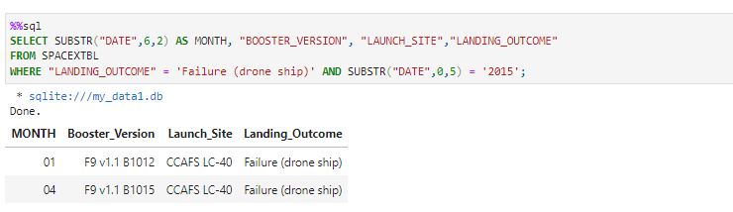
2015 Launch Records
We filter the failed landing outcomes in drone ship, their booster versions, and launch site names for year 2015

Slide 33
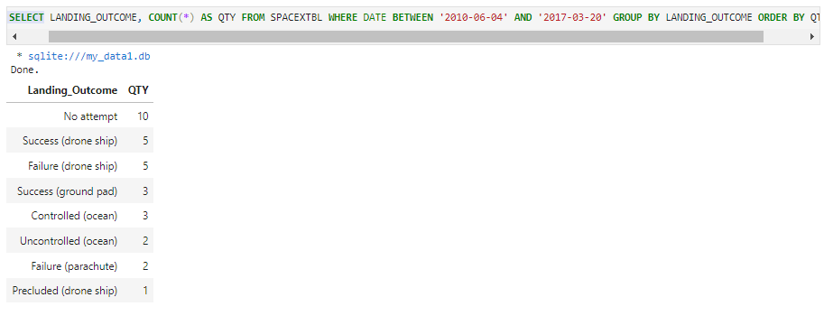
Rank Landing Outcomes Between 2010-06-04 and 2017-03-20
This query will provide us with a list of landing outcomes along with their corresponding quantities, filtered by specific dates and ordered from highest to lowest quantity.

Slide 34

Section 3

Slide 35
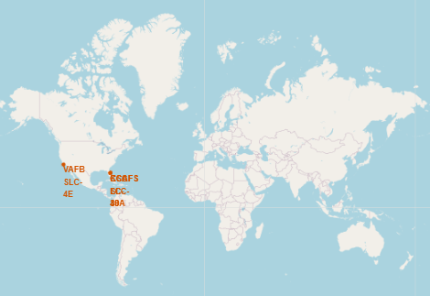
Launch Sites in global map
We generated a map with marked launch sites with Folium library

Slide 36
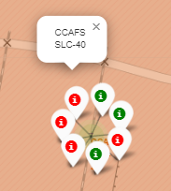
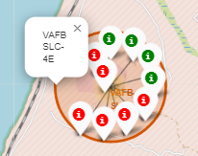
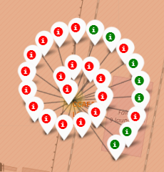
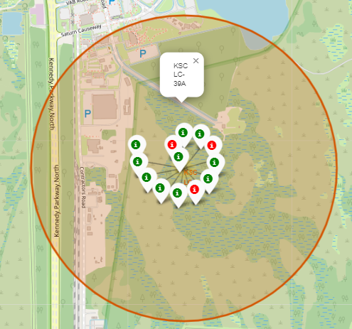
Color labeled markers in map
Green marker shows succesful launches and red marker shows Failures for each site launch

Slide 37
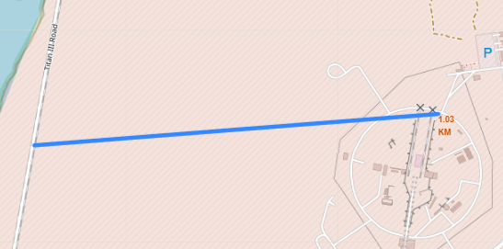
Distance lines to the proximities
We selected the Titan III Road and the distance is 1.03km

Slide 38

Section 4

Slide 39
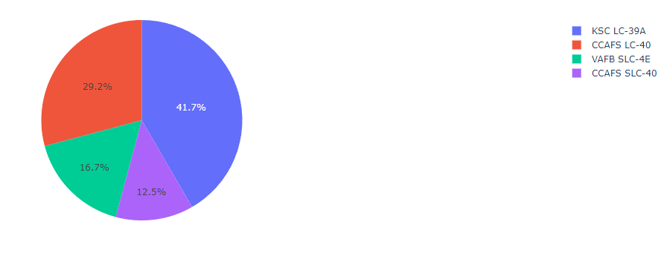
Pie chart of all sites SpaceX Launch Records
We can see that KSC LC 39-A had the highest percentage of successful launches

Slide 40
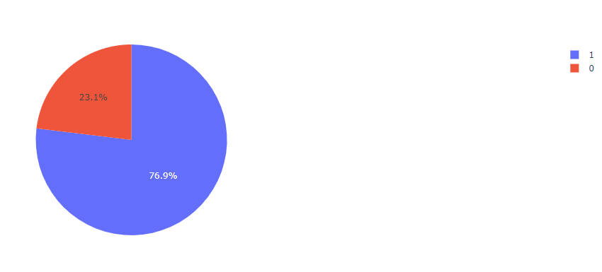
Pie chart of the Launch site with the highest launch success
KSC LC 39-A is de highest success launch site

Slide 41
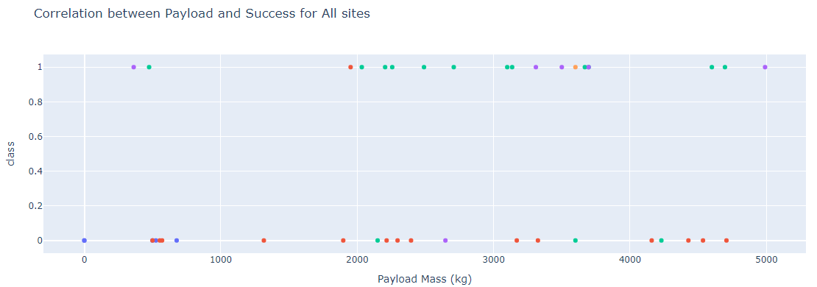
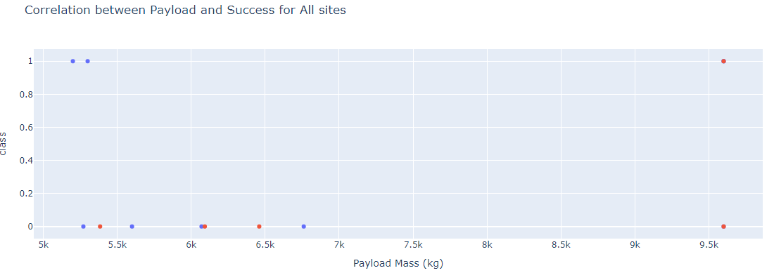
Scatter plot of Payload vs Launch Outcome for all sites
We can see that the low weighted payload (0kg-5000kg) had the highest success rates

Slide 42

Section 5

Slide 43
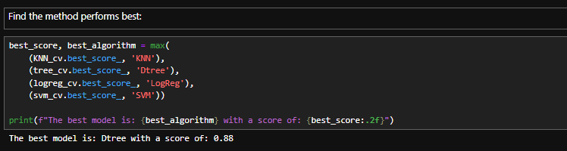
Classification Accuracy
The decision tree classifier is the model with the highest classification accuracy

Slide 44
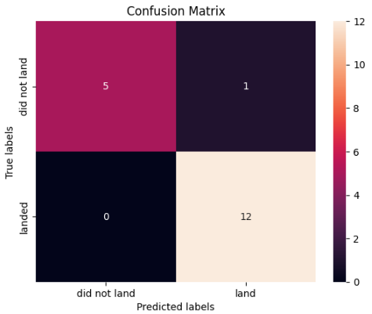
Confusion Matrix
The confusion matrix obtained using the Decision Tree Classifier algorithm in our launch outcomes analysis shows only 1 false positive, indicating high accuracy in predicting correct launches compared to other evaluated models.

Slide 45
Conclusions
We can conclude that:
Success rate since 2013 kept on increasing till 2020 Orbits ES-L1, GEO, HEO, SSO, VLEO had the most success rate.
KSC LC 39-A is de highest success launch site
The low weighted payload (0kg-5000kg) had the highest success rates
The decision tree classifier is known for its ability to learn non-linear relationships in the data and its easily interpretable nature.

Slide 46


